Slide 1
CEGE0004: Machine Learning for Data Science Lecture 1: Introduction Dr. Aldo Lipani

Slide 2
Welcome!
CEGE0004
Machine Learning for Data Science
Tutor: Dr. Aldo Lipani (aldo.lipani@ucl.ac.uk)
Use Moodle forum for questions!
https://moodle.ucl.ac.uk

Slide 3
This module provides an introduction to Machine Learning
in the context of Data Science.

Slide 4
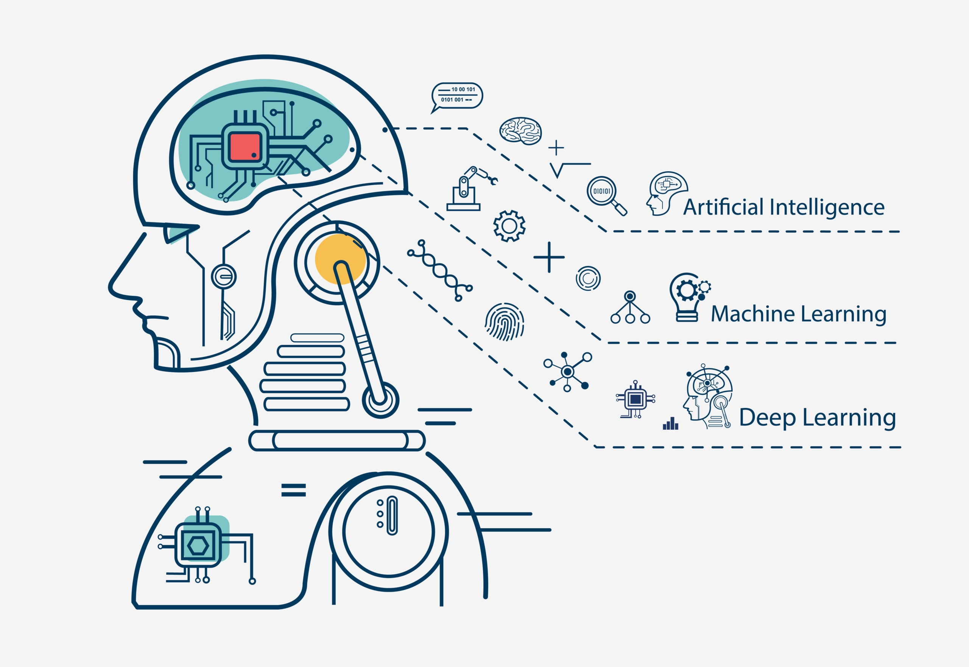
Learning Outcomes
To understand the basic principles of machine learning;
To be comfortable in applying appropriate ML methods to new data and tasks;
To understand the fundamentals of algorithms in ML and deep learning;
To have a general overview of the current AI technology and terminology.

Slide 5





Prerequisite
CEGE0096 or equivalent.
Programming knowledge:
Imperative programming;
Foundations of object-oriented programming;
Python and its ecosystem:
Anaconda
Jupiter notebooks
Git
PyCharm
Independence in solving problems computationally.
Foundations of Algebra, Calculus, Statistics and Probability Theory.

Slide 6

Module Venue and Schedule
Fully online.
Lectures and practicals will be released every Thursday.
1 hour of synchronous Q&A:
every Monday 2-3 PM (UK time).

Slide 7
Module Structure - Part I
Week | Content | Room Type
1 | Introduction | Lecture
 |  | Practical
2 | Decision Trees | Lecture
 |  | Practical
3 | Instance-Based Learning | Lecture
 |  | Practical
4 | Bayesian Learning | Lecture
 |  | Practical
5 | Neural Networks | Lecture
 |  | Practical

Slide 8
Module Structure - Part II
Week | Content | Room Type
6 | Model Ensembles | Lecture
 |  | Practical
7 | Learning Theory | Lecture
 |  | Practical
8 | Reinforcement Learning | Lecture
 |  | Practical
9 | Unsupervised Learning | Lecture
 |  | Practical
10 | Conclusion | Lecture
 |  | Practical

Slide 9

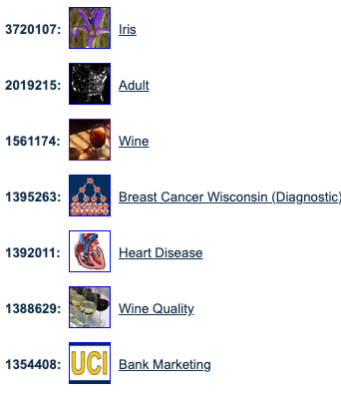
Assessments
Group Project (50%)
Develop machine learning solutions using real data.
Written Examination (50%)
Theory and exercises;
Open book, 24 hours (normally 2 hours).

Slide 10
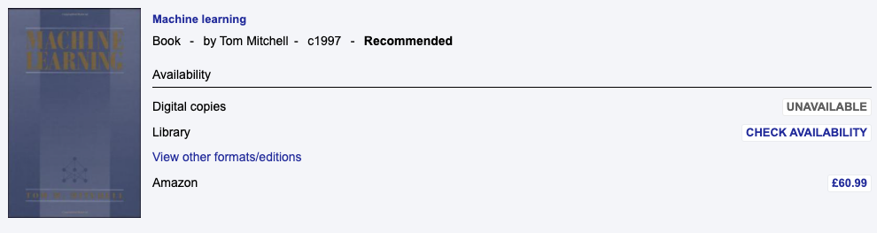
Recommended Readings
From Moodle (https://ucl.rl.talis.com/modules/cege0004.html)

Slide 11

Data Science

Slide 12
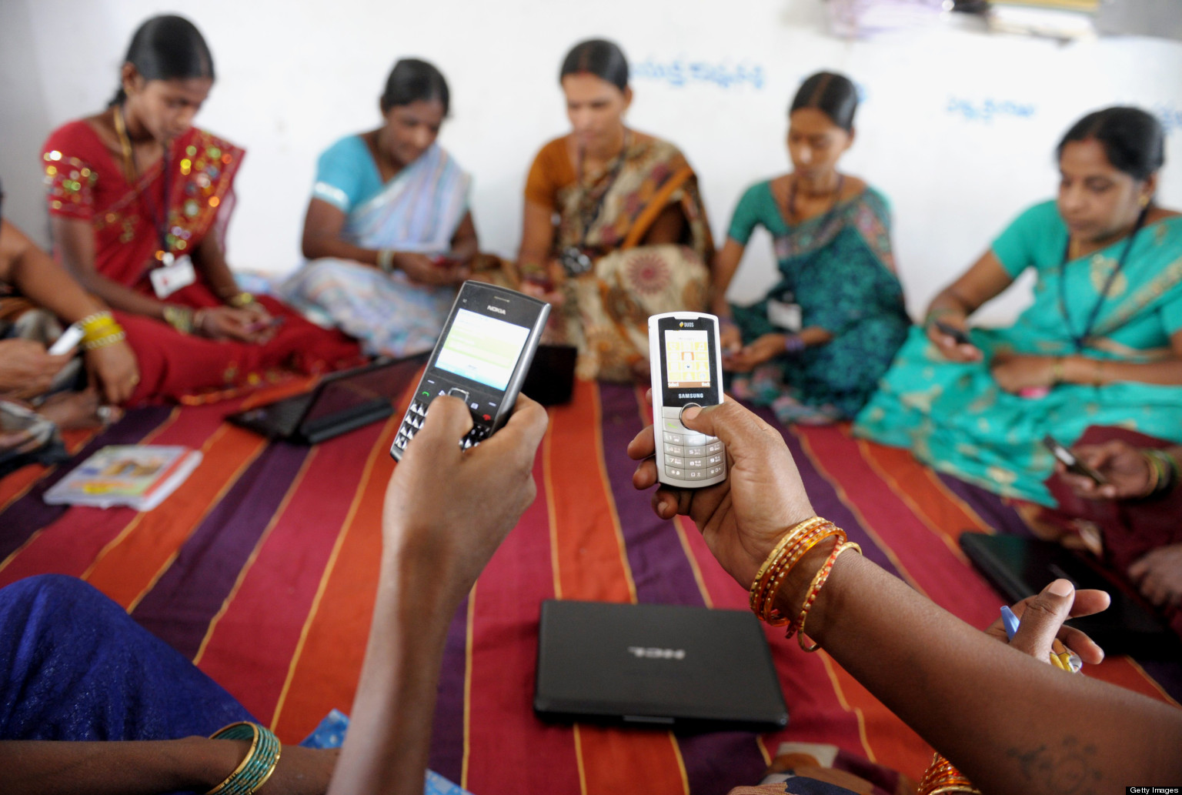

The World We Live In
The mobile revolution:
Soon, 8 billion people will have a cell phone;
Changing human behavior.
Explosion of Data:
Sensors (e.g., weather, IoT);
Purchase histories;
Trillions of photos are taken each year;
DNA sequencing;
…
Heterogeneity:
Data is unstructured;
Noisy;
Not collected systematically.

Slide 13

Enabling Technology
Explosion of storage and computational resources:
Massive data centers;
Computational power available to everybody;
350 years of statistics;
100 years of numerical analysis.

Slide 14
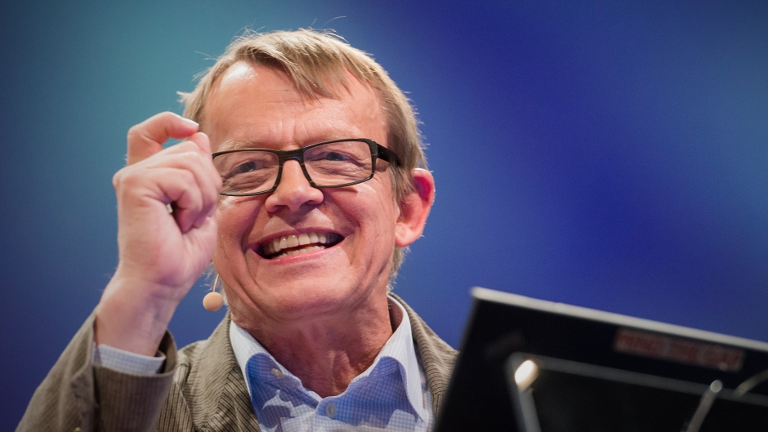
What is a Data Scientist?
A data scientist should:
Understand the background domain;
Design solutions that produce added value to the organization;
Implement the solutions efficiently;
Communicate the findings clearly.
A data scientist is a practitioner with sufficient expertise in software engineering, statistics/machine learning, and the application domain.
Hans Rosling: The best stats you've ever seen.

Slide 15
What is Data Science?
"Data Scientist means a professional who uses scientific methods to liberate and create meaning from raw data." Data Science Associations' "Professional Code of Conduct".
Statistics means the practice or science of collecting and analyzing numerical data in large quantities.
"Why do we need data science when we've had statistics for centuries?" Irving Wladawsky-Berger.
"When physicists do mathematics, they don't say they're doing number science. They're doing math. If you're analyzing data, you're doing statistics." Karl Broman, Univ. Wisconsin.
"Data science without statistics is possible, even desirable." Vincent Granville.
"Statistics is the least important part of data science." Andrew Gelman, Columbia University.
So, what is data science?

Slide 16
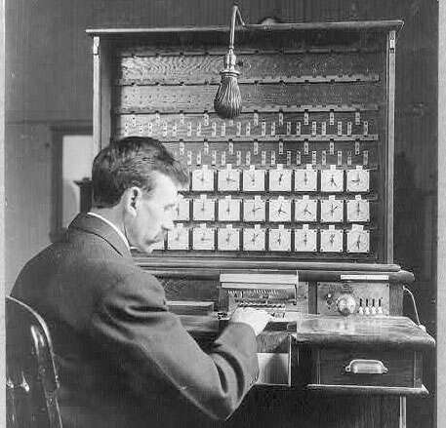
The Big Data Meme
Statistics deal with small data while data science with big data…
The term "statistics" was coined around 200 years ago at the beginning of modern efforts to compile census data (roughly the scale of today's big data).
A statistician, Hollerith, invented the first major advance in big data: the punched card reader. This led to the formation of IBM.
Mathematical statistics researchers have pursued the scientific understanding of big datasets for decades.
focused on what happens when a database has many individuals, measurements or both.

Slide 17

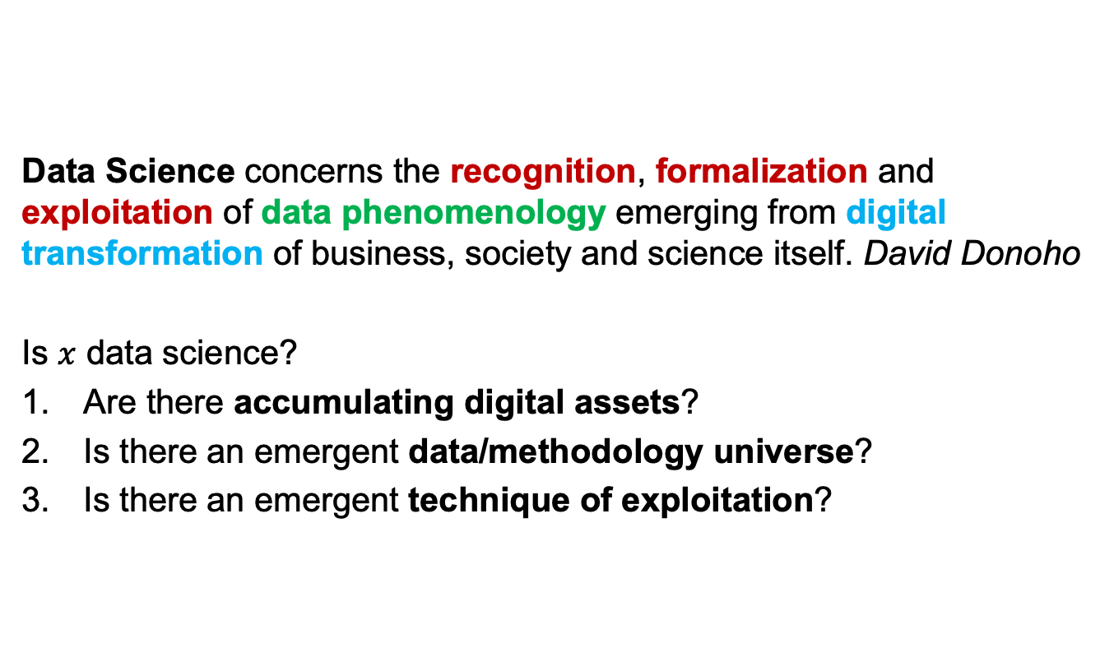
Data Science
Data Science concerns the recognition, formalization and exploitation of data phenomenology emerging from digital transformation of business, society and science itself. David Donoho
Is $x$ data science?
Are there accumulating digital assets?
Is there an emergent data/methodology universe?
Is there an emergent technique of exploitation?

Slide 18
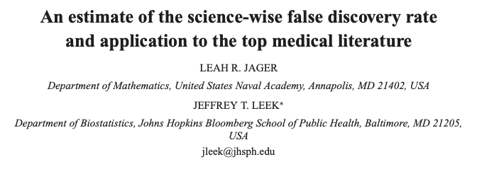
An Example that Qualifies as Data Science
Accumulating digital assets: Database, software for text scraping
Emerging data/methodology universe: All PubMed abstracts
Emergent techniques of exploitation: Stats about scientific activity

Slide 19

Is the Success of Deep Learning the Result of Data Science?
In 2010, Fei Fei Li starts ImageNet competition.
Accumulating digital assets: Cluster computing
Emerging data/methodology universe: Image database
Emergent techniques of exploitation: Prediction challenges

Slide 20
The 6 Data Science Activities
Data gathering, preparation, and exploration;
Data representation and transformation;
Computing with data;
Data visualization and presentation;
Data Modeling;
Generative modeling - Statistics;
Predictive modeling - Machine Learning.
Science about Data Science.

Slide 21
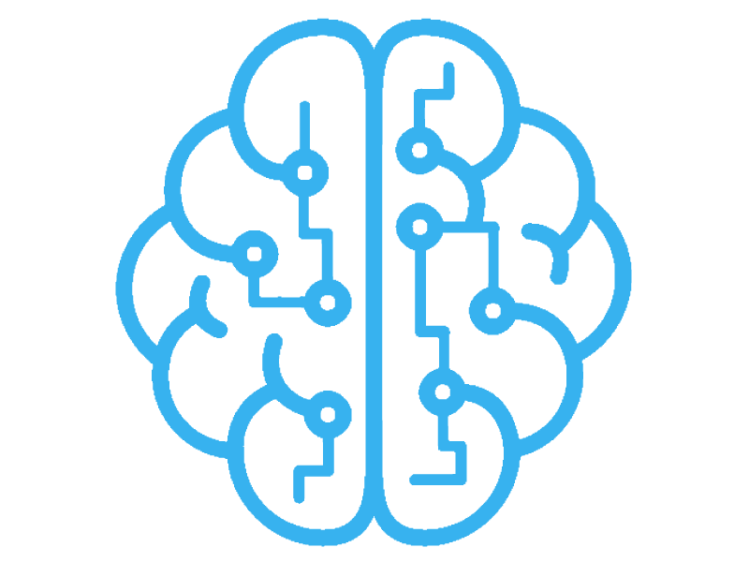
Machine Learning

Slide 22
What is Machine Learning?
“Learning is any process by which a system improves performance from experience.”
“Machine Learning is concerned with computer programs that automatically improve their performance through experience.”
~ Herbert Simon
“Machine Learning is the study of algorithms that improve their:
performance P
at some task T
with experience E”
~ Tom Mitchel
Notes:
Herbert A. Simon, Nobel prize in economics (1978) founding father of AI
Tom Mitchel is a professor of machine learning at CMU

Slide 23
Machine Learning as a New Programming Paradigm
Traditional Programming
Data
Output
Program
Machine Learning
Data
Program
Output

Slide 24
Types of Learning
Supervised Learning
is when for every data-point we have a desired output is given.
Unsupervised Learning
is when we have no desired output;
Semi-supervised Learning
is when for some data-point we have a desired output;
Reinforcement Learning
is when the discovery of the desired output is part of the task.
(Too abstract? Some examples in the next slides)

Slide 25
Some Classic Examples (Supervised Learning)

Slide 26
Some Classic Examples (Unsupervised)
Notes:
Dataset
-- Iris Setosa -- Iris Versicolour -- Iris Virginica
Independent component analysis – separate a combined signal into its original sources.

Slide 27
Reinforcement Learning
https://deepmind.com/alphago-games-english
https://deepmind.com/blog/article/alphastar-mastering-real-time-strategy-game-starcraft-ii

Slide 28




When should we use Machine Learning?
We do not have an expertise (navigating on Mars)
We can’t explain our expertise (speech recognition, vision)
We must customize our models (personalized medicine, personalized search results)
We want to understand huge amounts of data (genomics)
When is learning not useful?

Slide 29
Machine Learning in a Nutshell
There exists tens of thousands of machine learning algorithms and hundreds new algorithms every year.
Every machine learning algorithm has three components:
Representation – How knowledge is represented;
Evaluation – The way to evaluate candidate hypotheses;
Optimization – The way candidate hypotheses are generated.
ML algorithm

Slide 30
The 5 Machine Learning Churches
Symbolists
Logic/Accuracy/Inverse Deduction
Connectionists
Neural Networks/Squared Error/Gradient Descent
Evolutionists
Genetic Programs/Fitness/Genetic Search
Bayesians
Graphical Models/Likelihood/Probabilistic Inference
Analogizes
Support Vectors/Margin/Constrained Optimization

Slide 31
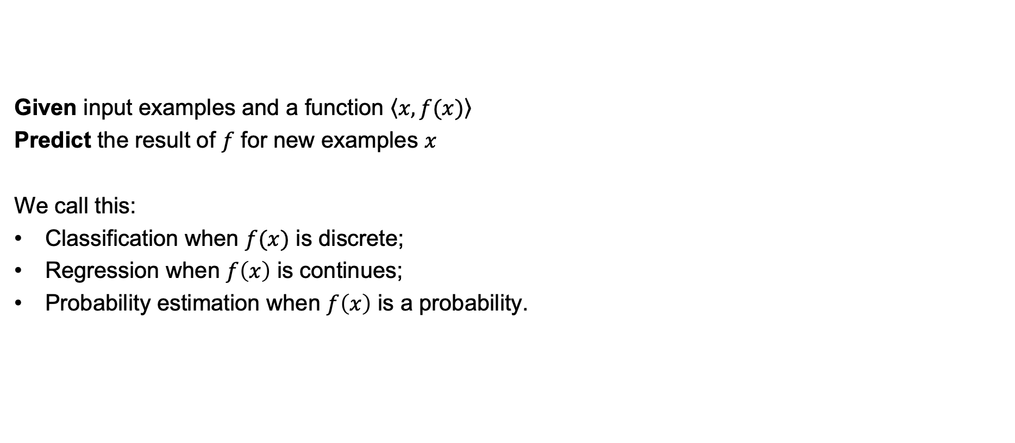
Inductive Learning
Given input examples and a function $\left\langle \left.x, f(x)\right\rangle \right.$
Predict the result of $f$ for new examples $x$
We call this:
Classification when $f(x)$ is discrete;
Regression when $f\left(x\right)$ is continues;
Probability estimation when $f\left(x\right)$ is a probability.

Slide 32
Representation/Evaluation/Optimization
Numerical functions
Linear regression
Neural networks
Support vector machines
Symbolic functions
Decision trees
Rules in propositional logic
Rules in first-order predicate logic
Instance-based functions
Nearest-neighbor
Case-based
Probabilistic Graphical Models
Naïve Bayes
Bayesian networks
Hidden-Markov Models
Genetic Algorithms
Accuracy
Precision and recall
Squared error
Likelihood
Cost / Utility
Margin
Entropy
K-L divergence
Gradient descent
Perceptron
Backpropagation
Dynamic Programming
HMM Learning
PCFG Learning
Divide and Conquer
Decision tree induction
Rule learning
Evolutionary Computation
Genetic Algorithms (GAs)
Genetic Programming (GP)
Neuro-evolution

Slide 33
Inductive Learning

Slide 34
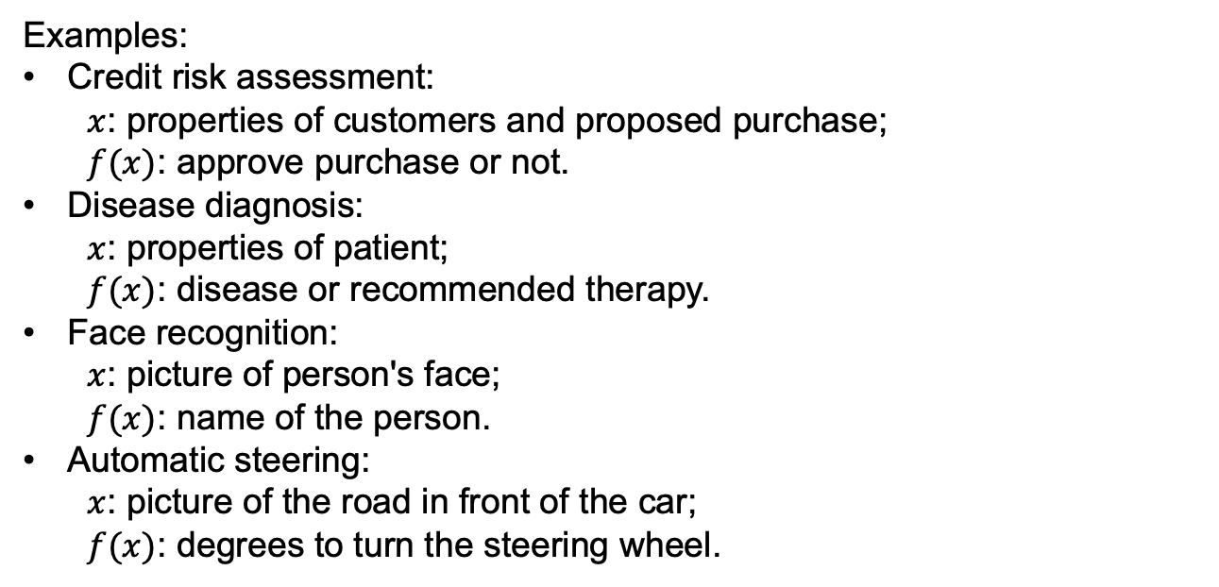
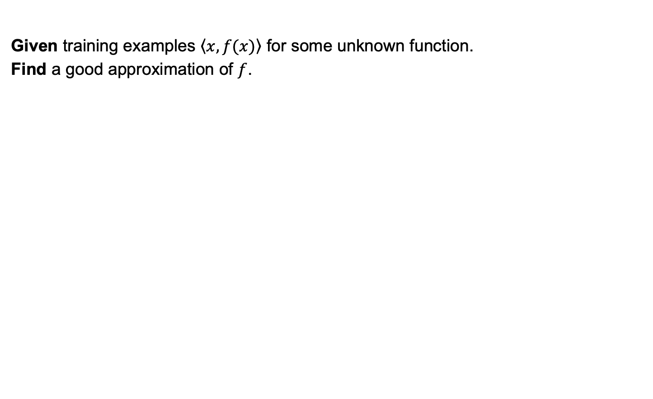
Inductive Learning
Given training examples $\left\langle \left.x, f(x)\right\rangle \right.$ for some unknown function.
Find a good approximation of $f$.
Examples:
Credit risk assessment: $x$: properties of customers and proposed purchase; $f(x)$: approve purchase or not.
Disease diagnosis: $x$: properties of patient; $f(x)$: disease or recommended therapy.
Face recognition: $x$: picture of person's face; $f(x)$: name of the person.
Automatic steering: $x$: picture of the road in front of the car; $f(x)$: degrees to turn the steering wheel.

Slide 35
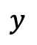
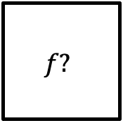
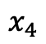
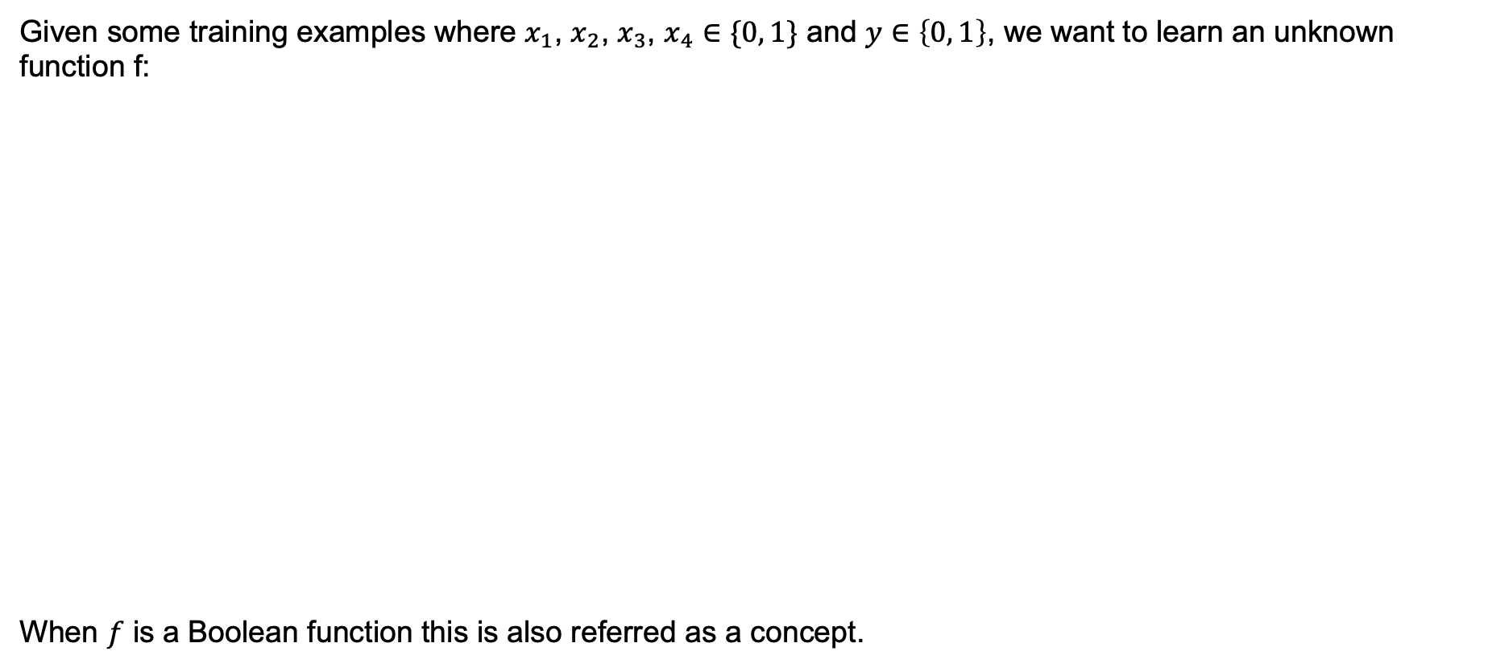
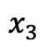
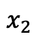
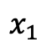
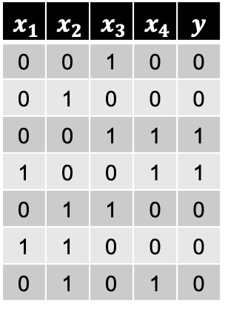
A Learning Problem
Given some training examples where $x_{1}$, $x_{2}$, $x_{3}$, $x_{4}∈\{0, 1\}$ and $y∈\left\{0, 1\right\}$, we want to learn an unknown function f:
When $f$ is a Boolean function this is also referred as a concept.
$$x_{1}$$ | $$x_{2}$$ | $$x_{3}$$ | $$x_{4}$$ | $$y$$
0 | 0 | 1 | 0 | 0
0 | 1 | 0 | 0 | 0
0 | 0 | 1 | 1 | 1
1 | 0 | 0 | 1 | 1
0 | 1 | 1 | 0 | 0
1 | 1 | 0 | 0 | 0
0 | 1 | 0 | 1 | 0
$$x_{1}$$
$$f?$$
$$x_{2}$$
$$x_{3}$$
$$y$$
$$x_{4}$$

Slide 36
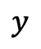
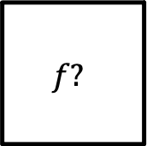
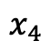
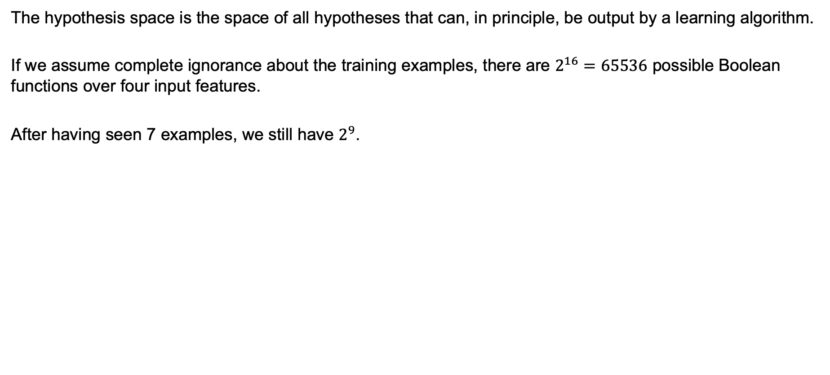
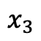
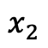
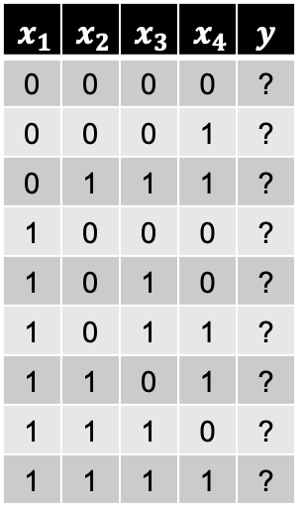
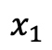
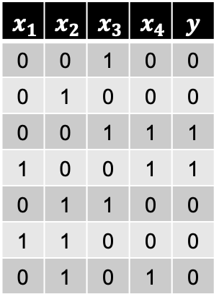
Hypothesis Space
The hypothesis space is the space of all hypotheses that can, in principle, be output by a learning algorithm.
If we assume complete ignorance about the training examples, there are $2^{16}=65536$ possible Boolean functions over four input features.
After having seen 7 examples, we still have $2^{9}$.
$$x_{1}$$ | $$x_{2}$$ | $$x_{3}$$ | $$x_{4}$$ | $$y$$
0 | 0 | 0 | 0 | ?
0 | 0 | 0 | 1 | ?
0 | 1 | 1 | 1 | ?
1 | 0 | 0 | 0 | ?
1 | 0 | 1 | 0 | ?
1 | 0 | 1 | 1 | ?
1 | 1 | 0 | 1 | ?
1 | 1 | 1 | 0 | ?
1 | 1 | 1 | 1 | ?
$$x_{1}$$ | $$x_{2}$$ | $$x_{3}$$ | $$x_{4}$$ | $$y$$
0 | 0 | 1 | 0 | 0
0 | 1 | 0 | 0 | 0
0 | 0 | 1 | 1 | 1
1 | 0 | 0 | 1 | 1
0 | 1 | 1 | 0 | 0
1 | 1 | 0 | 0 | 0
0 | 1 | 0 | 1 | 0
$$x_{1}$$
$$f?$$
$$x_{2}$$
$$x_{3}$$
$$y$$
$$x_{4}$$

Slide 37

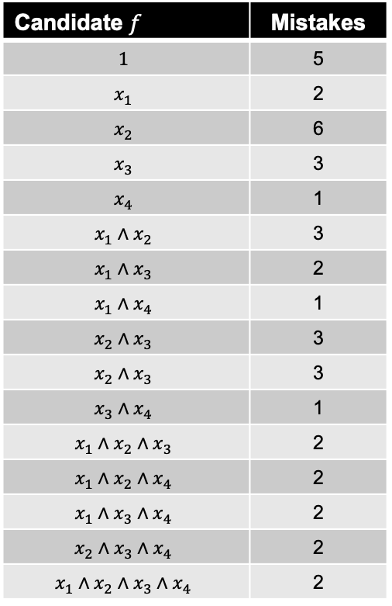
Hypothesis Space: Simple Rules
Assuming that the hypothesis space is made of conjunctive rules, we then have only 16:
Candidate $f$ | Mistakes
$$1$$ | 5
$$x_{1}$$ | 2
$$x_{2}$$ | 6
$$x_{3}$$ | 3
$$x_{4}$$ | 1
$$x_{1}∧x_{2}$$ | 3
$$x_{1}∧x_{3}$$ | 2
$$x_{1}∧x_{4}$$ | 1
$$x_{2}∧x_{3}$$ | 3
$$x_{2}∧x_{3}$$ | 3
$$x_{3}∧x_{4}$$ | 1
$$x_{1}∧x_{2}∧x_{3}$$ | 2
$$x_{1}∧x_{2}∧x_{4}$$ | 2
$$x_{1}∧x_{3}∧x_{4}$$ | 2
$$x_{2}∧x_{3}∧x_{4}$$ | 2
$$x_{1}∧x_{2}∧x_{3}∧x_{4}$$ | 2
$$x_{1}$$ | $$x_{2}$$ | $$x_{3}$$ | $$x_{4}$$ | $$y$$
0 | 0 | 1 | 0 | 0
0 | 1 | 0 | 0 | 0
0 | 0 | 1 | 1 | 1
1 | 0 | 0 | 1 | 1
0 | 1 | 1 | 0 | 0
1 | 1 | 0 | 0 | 0
0 | 1 | 0 | 1 | 0

Slide 38
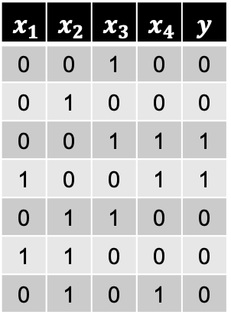
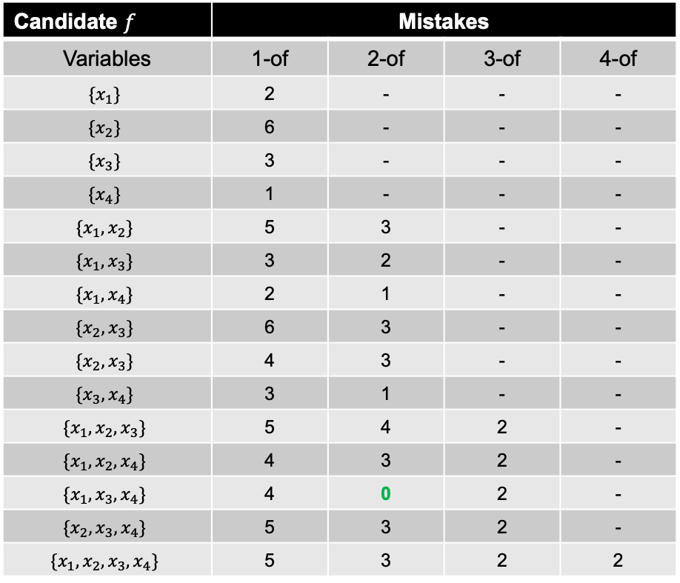
Hypothesis Space: m-of-n-rules
Assuming that the hypothesis space is m-of-n rules, we then have 32:
Candidate $f$ | Mistakes |  |  | Mistakes
Variables | 1-of | 2-of | 3-of | 4-of
$$\{x_{1}\}$$ | 2 | - | - | -
$${\{x}_{2}\}$$ | 6 | - | - | -
$${\{x}_{3}\}$$ | 3 | - | - | -
$${\{x}_{4}\}$$ | 1 | - | - | -
$${\{x}_{1},x_{2}\}$$ | 5 | 3 | - | -
$${\{x}_{1},x_{3}\}$$ | 3 | 2 | - | -
$${\{x}_{1},x_{4}\}$$ | 2 | 1 | - | -
$${\{x}_{2},x_{3}\}$$ | 6 | 3 | - | -
$${\{x}_{2},x_{3}\}$$ | 4 | 3 | - | -
$${\{x}_{3},x_{4}\}$$ | 3 | 1 | - | -
$${\{x}_{1},x_{2},x_{3}\}$$ | 5 | 4 | 2 | -
$${\{x}_{1},x_{2},x_{4}\}$$ | 4 | 3 | 2 | -
$${\{x}_{1},x_{3},x_{4}\}$$ | 4 | 0 | 2 | -
$${\{x}_{2},x_{3},x_{4}\}$$ | 5 | 3 | 2 | -
$${\{x}_{1},x_{2},x_{3},x_{4}\}$$ | 5 | 3 | 2 | 2
conjunctions are included
$$x_{1}$$ | $$x_{2}$$ | $$x_{3}$$ | $$x_{4}$$ | $$y$$
0 | 0 | 1 | 0 | 0
0 | 1 | 0 | 0 | 0
0 | 0 | 1 | 1 | 1
1 | 0 | 0 | 1 | 1
0 | 1 | 1 | 0 | 0
1 | 1 | 0 | 0 | 0
0 | 1 | 0 | 1 | 0

Slide 39
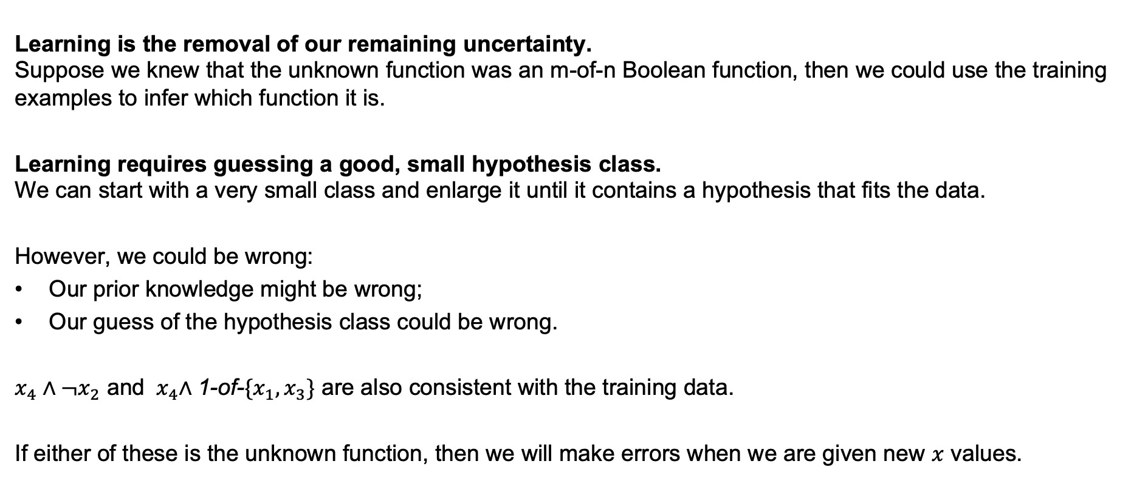
Two Views of Learning
Learning is the removal of our remaining uncertainty. Suppose we knew that the unknown function was an m-of-n Boolean function, then we could use the training examples to infer which function it is.
Learning requires guessing a good, small hypothesis class. We can start with a very small class and enlarge it until it contains a hypothesis that fits the data.
However, we could be wrong:
Our prior knowledge might be wrong;
Our guess of the hypothesis class could be wrong.
$x_{4}∧¬x_{2}$ and ${ x}_{4}∧$1-of-$\{x_{1},x_{3}\}$ are also consistent with the training data.
If either of these is the unknown function, then we will make errors when we are given new $x$ values.

Slide 40
Key Issues in Machine Learning
What are good hypothesis spaces? Which spaces have been useful in practical applications and why?
What algorithms can work with these spaces? Are there general design principles for machine learning algorithms?
How can we optimize accuracy on future data points? This is sometimes called the "problem of overfitting".
How do we have confidence in the model?
Are there learning problems that are computationally intractable?
How can we formulate application problems as machine learning problems?

Slide 41
Hypothesis Spaces
What is the size of the hypothesis space?
Fixed-size spaces are easier to understand;
Variable-size spaces are generally more useful.
How are hypothesis evaluated, deterministically or stochastically?
For deterministic hypotheses, a training example is either consistent or inconsistent;
For stochastic hypotheses, a training example is more likely or less likely.
Is the hypothesis symbolic (discrete) or continuous?
Symbolic when described by a set of discrete choices, found by combinatorial search methods;
Continues when described by a set of continues parameters, found by numerical search methods;
Mixed hypotheses when both kinds are needed.

Slide 42
Learning Algorithms
Search procedure:
Direct computation: No search, just calculate what is needed;
Local search: start with an initial hypothesis and refine it;
Constructive search: build the hypothesis from scratch.
Timing:
Lazy: Learning performed at the time that is needed;
Eager: Learning is performed upfront;
Online: Learning based on each pattern as it is observed;
Batch: Collect training examples, analyze them, output a hypothesis.

